Slide 1
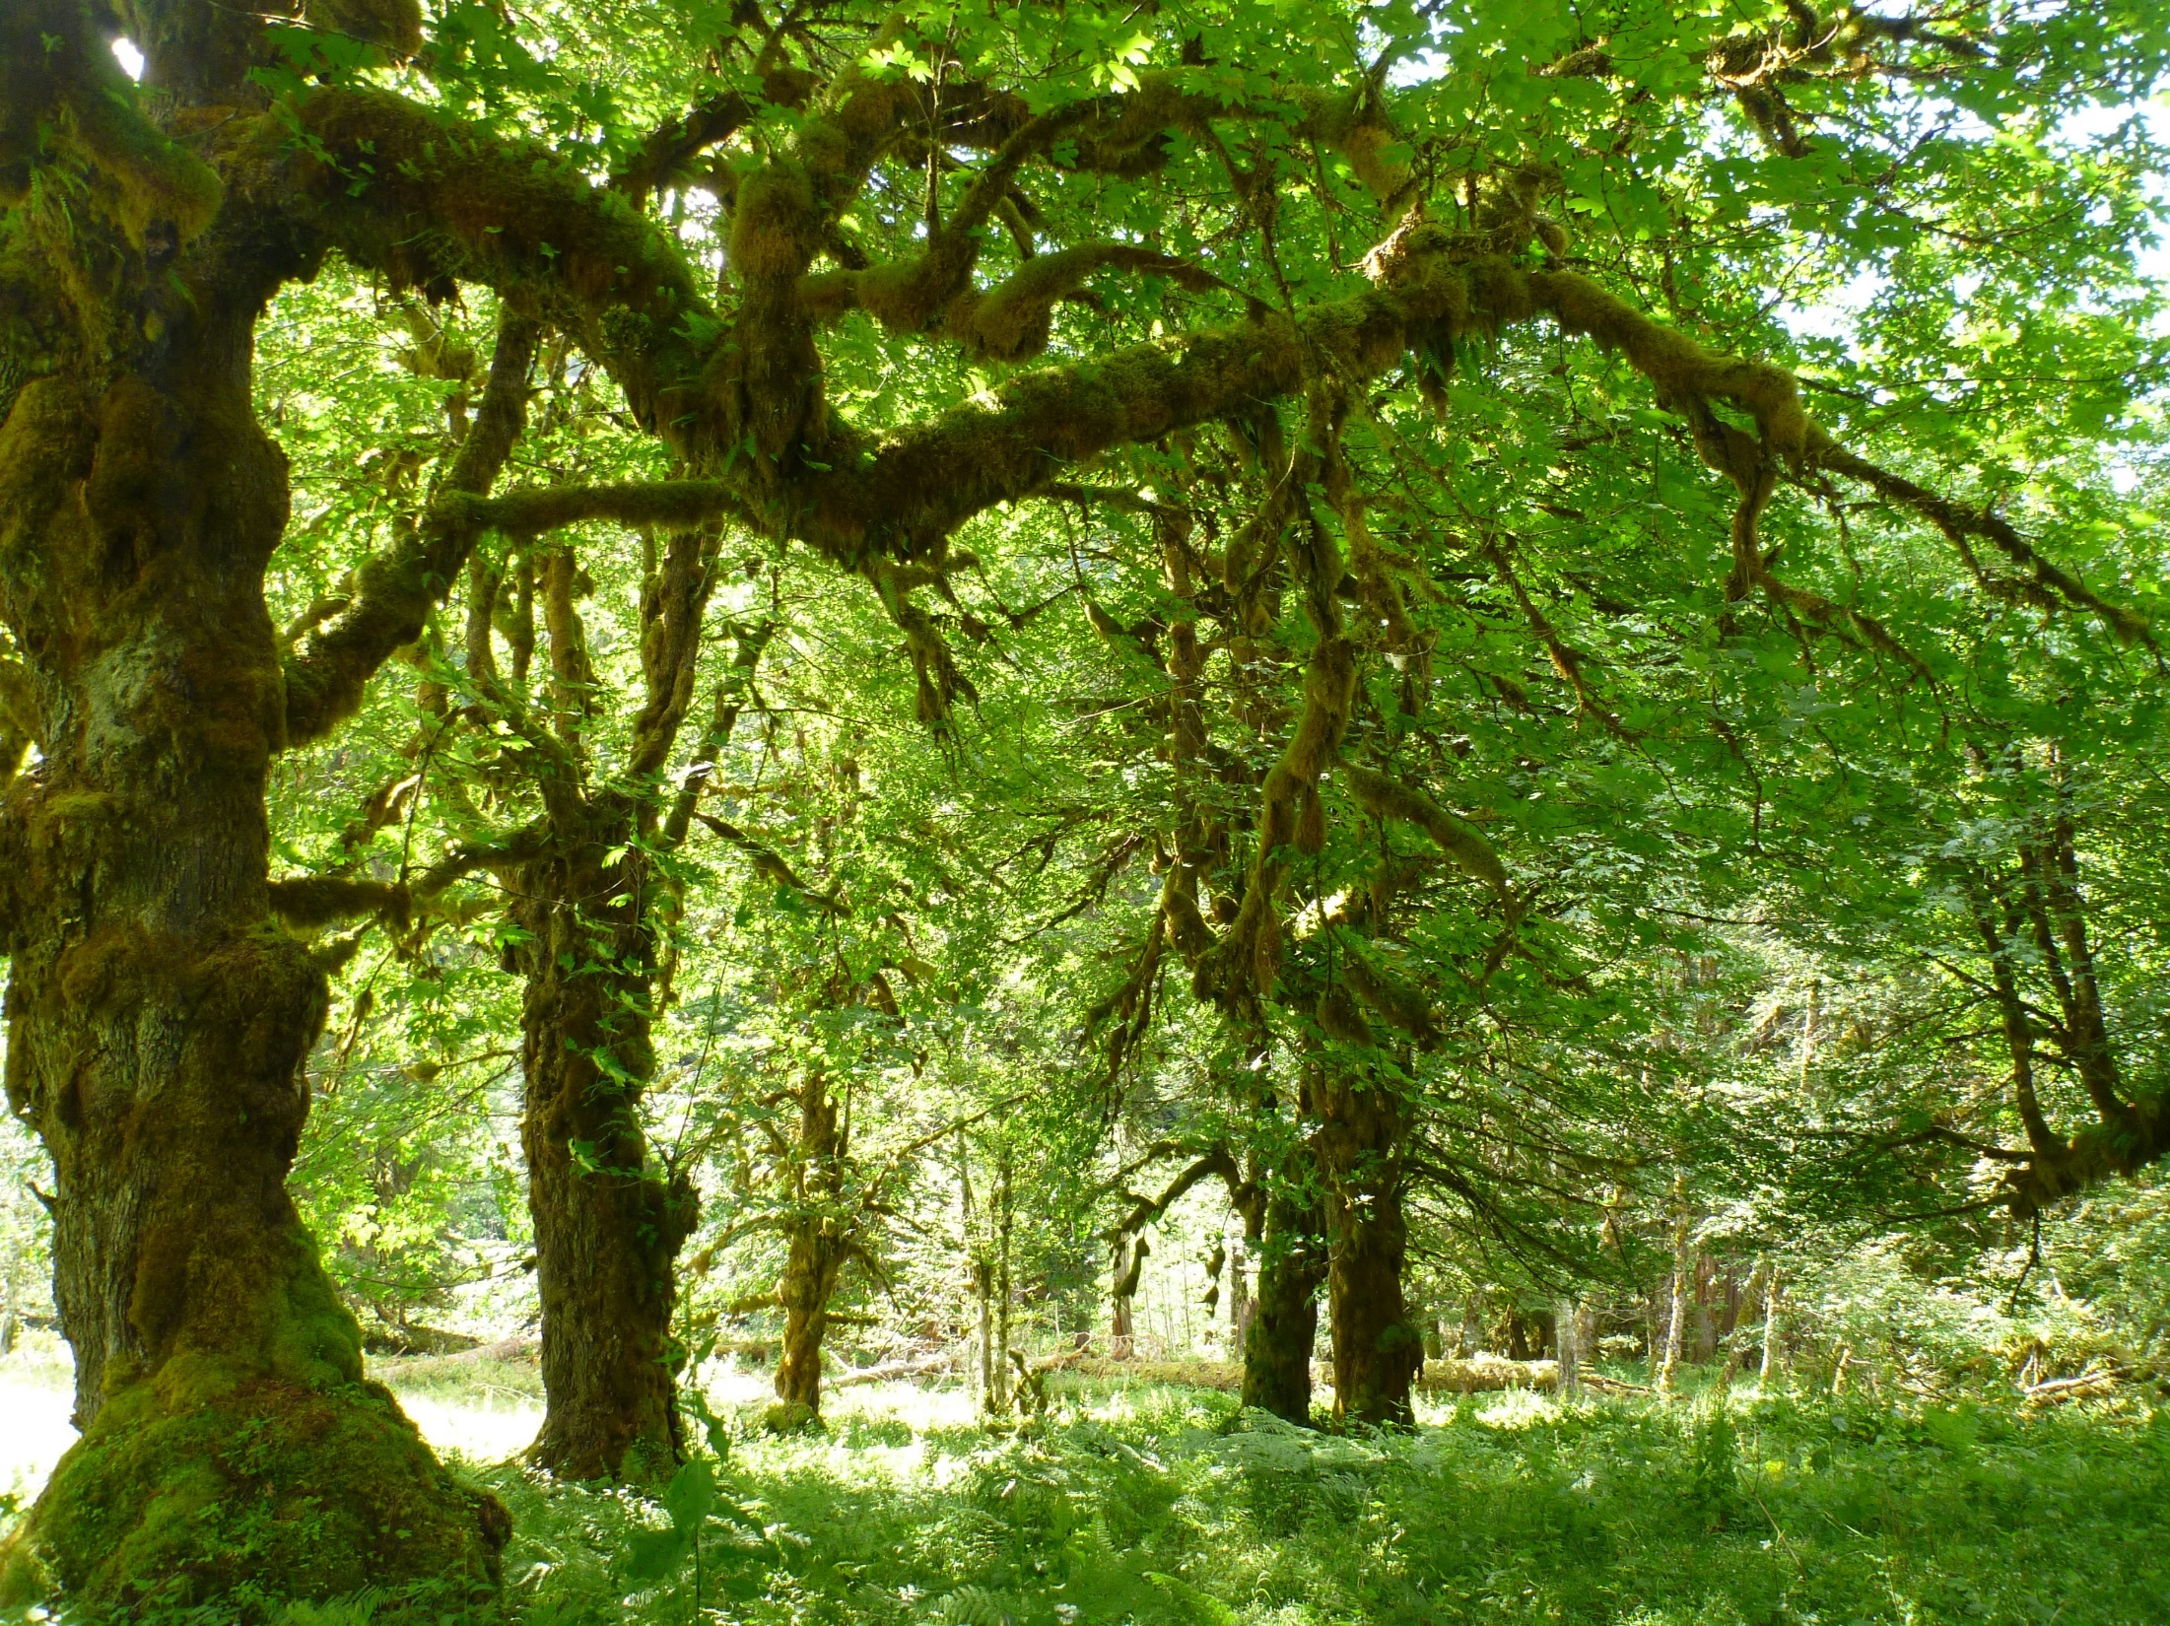
Tree-based Models Statistics for Soil Survey

Slide 2
Outline
Part 1 – CART models
Overview and Concepts
Examples
Advantages over other modeling methods
Rpart Method
Splitting criteria for Regression and Classification
Pruning with Cost Complexity parameter
Model Validation
Part 2 – Random Forest models
Random Forest Methods
Bootstrap Aggregation and Bagging
Variable Importance and OOB
Gradient Descent
Ranger package
Boosted tree models
Deep Learning

Slide 3
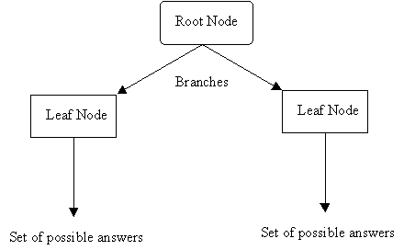
What is a Decision Tree?
Instead of fitting a model to the data, a decision tree model recursively partitions the data into increasingly homogenous groups based on values that minimize a loss function (such as Sum of Squared Errors (SSE)).
Notes:
Show of hands – who has heard of this before – tree models, classification/regression trees, random forests, etc.

Slide 4
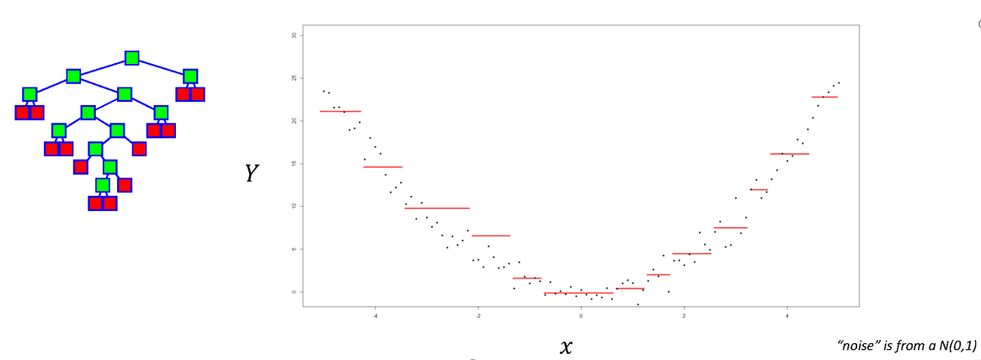
Decision Tree Concepts
Divide predictor variables into different regions so that the dependent variable can be predicted more accurately.
Predicted values from a Decision Tree to the curve Y = X² + noise

Slide 5
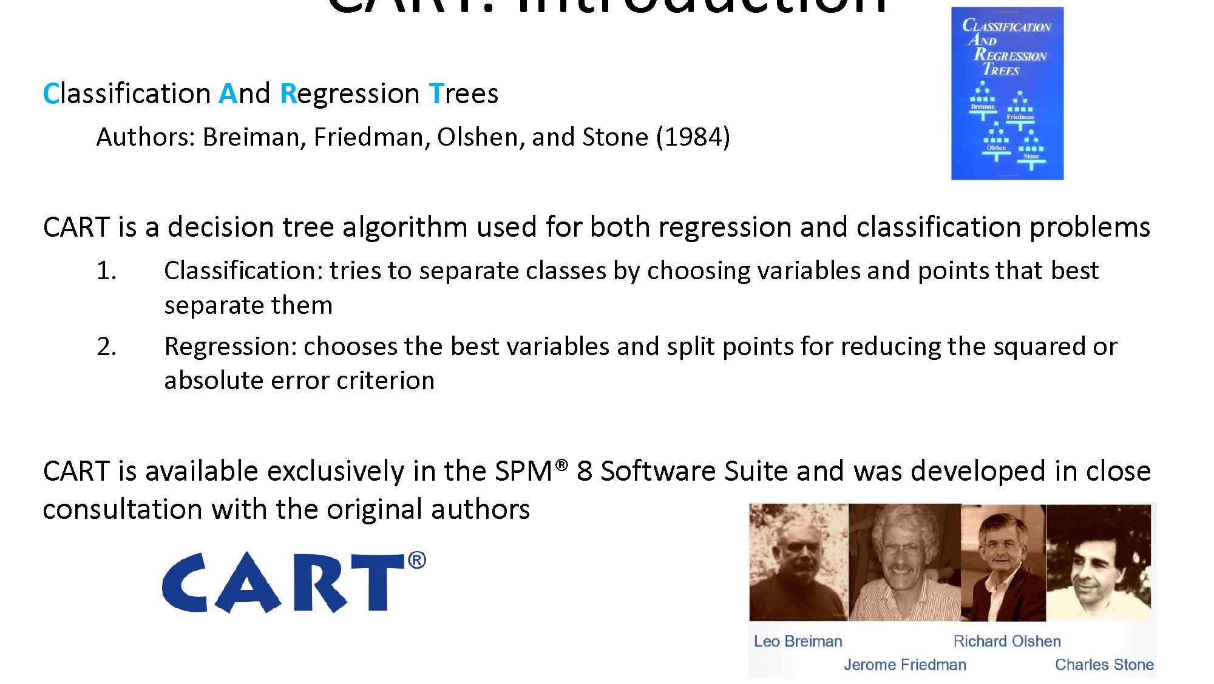
Notes:
From salford systems presentation – acquired by minitab

Slide 6
Decision Tree Examples
Argillic Horizon
No
Yes
Dominant Vegetation
Base Saturation
Hardwood
Conifer, Mixed
<35%
>35%
Inceptisols
Spodosols
Ultisols
Alfisols
Notes:
Closely resembles human reasoning - heuristics

Slide 7
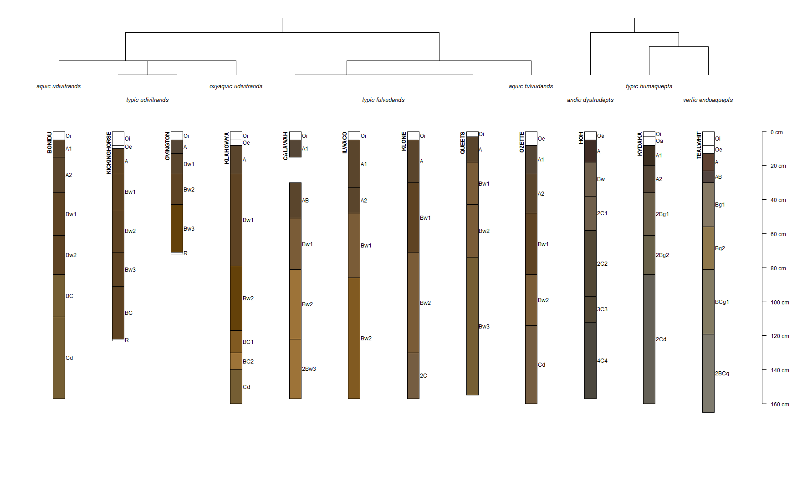
Notes:
Relate to taxonomic keys – dichotomous keys in botany, etc.
This is an OSD querry (fetchOSD and plot the SPC) w/ taxonomic dendrogram

Slide 8


Slide 9
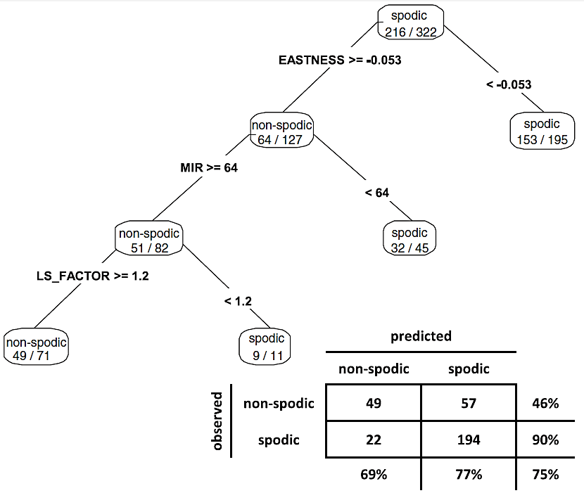
Prediction of Soil Properties
From Nauman et al., 2015
Notes:
This is what we looked in the GLM exercises in day 3/4
Confusion Matrix – whats the OA?
Will revisit this later

Slide 10
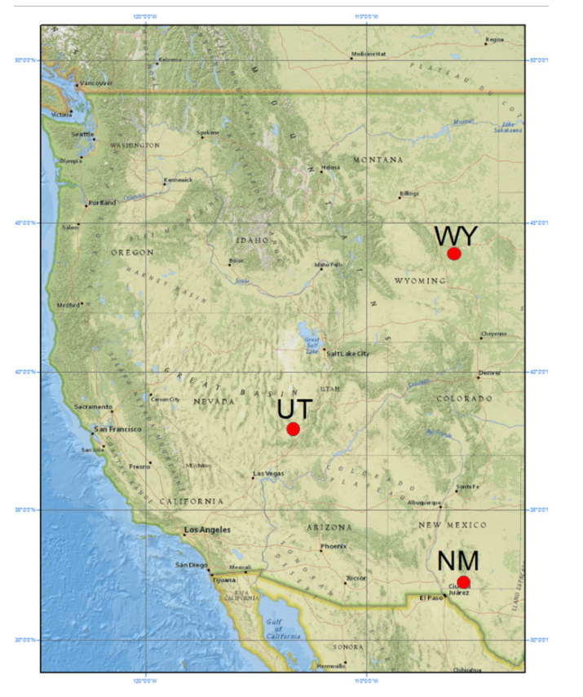
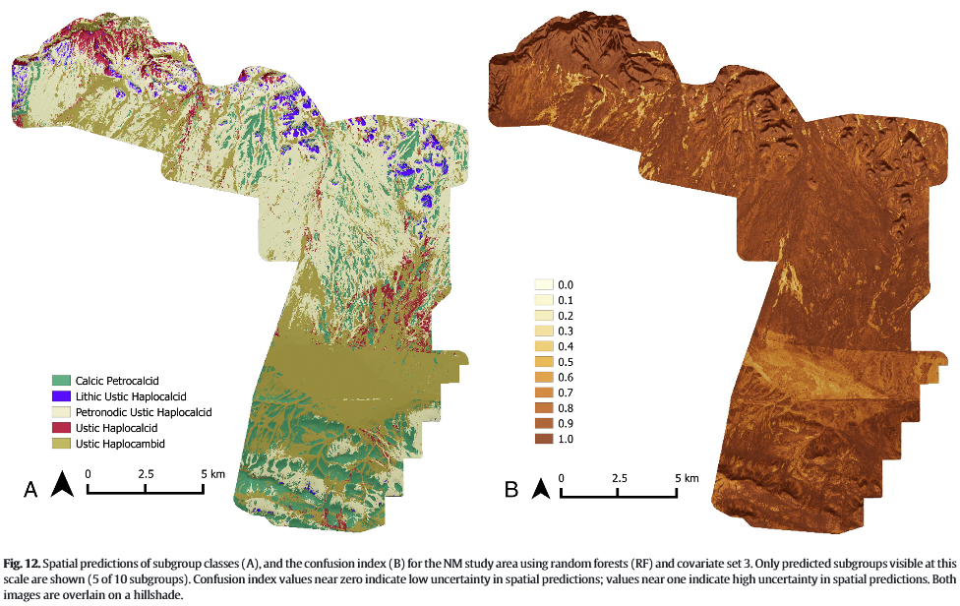
Prediction of Soil Classes
Are Very Accurate Predictors
From Brungard et al., 2015
Notes:
In predicting soil classes in across three study area in UT, WY, and NM, random forest outperformed 10 other ML classifiers
Accurate but tends to over-fit

Slide 11
Common Issues with Regression
Missing Values
require imputation
results in record deletion
limited “high value” observations
Nonlinearity
Y = 10 + 3X₁ – 2X₂ + 0.3X₁²
difficult to account for local effects
Assumes a normal distribution
Interactions
Y = 10 + 3X₁ – 2X₂ + 0.25X₁X₂
i.e. forward / backward / stepwise regression

Slide 12
Advantages of Tree-based Models
Closely resemble human reasoning
Quickly executed
Do not assume / require normality
Handles both continuous and categorical data
Perform Regression and Classification
*Easily interpretable results
Handles missing values and dirty data
Useful for exploratory analysis and prediction

Slide 13
Tree-based Models in R
rpart
caret
randomForest
ranger
GBM / XGB

Slide 14
Rpart Method
Start with all cases at the root node and select the variable/value (X=t₁) that best splits the data into homogeneous groups (sum of squared errors for regression and entropy, Gini measure, or Information Gain for classification).
If X< t₁ then the data are sent to the left; otherwise, the data are sent to the right.
Repeat this process until the objective is met.
Comments:
Once the cases are split, they are never rejoined
A given variable can be used multiple times in a tree
Pruning may be necessary to reduce over-fitting
Notes:
Tree grows upside down with root at top
Mention information index for splitting in addition to Gini
Info gain is the inverse of entropy (relate to Shannon’s Entropy)

Slide 15
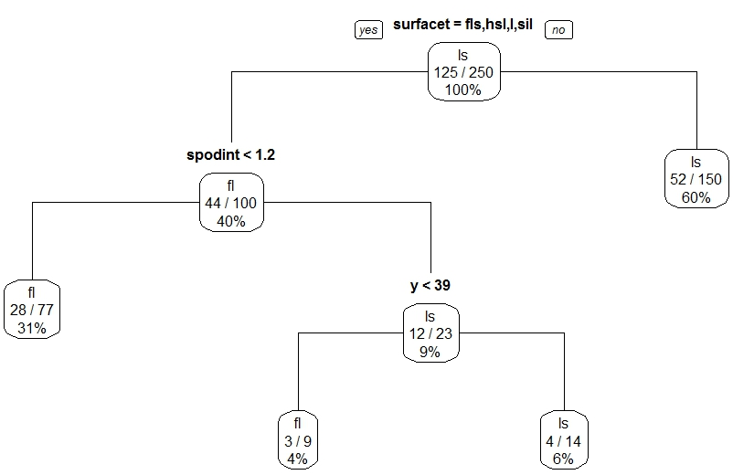
Rpart Classification Tree
Terminal nodes are categorical -- the class with the majority of votes wins.
Notes:
This is what we looked in the GLM exercises – same dataset, etc day 3/4

Slide 16
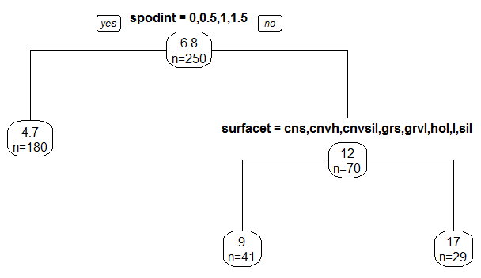
Rpart Regression Tree
Terminal nodes represent the mean of the observations in that node.

Slide 17
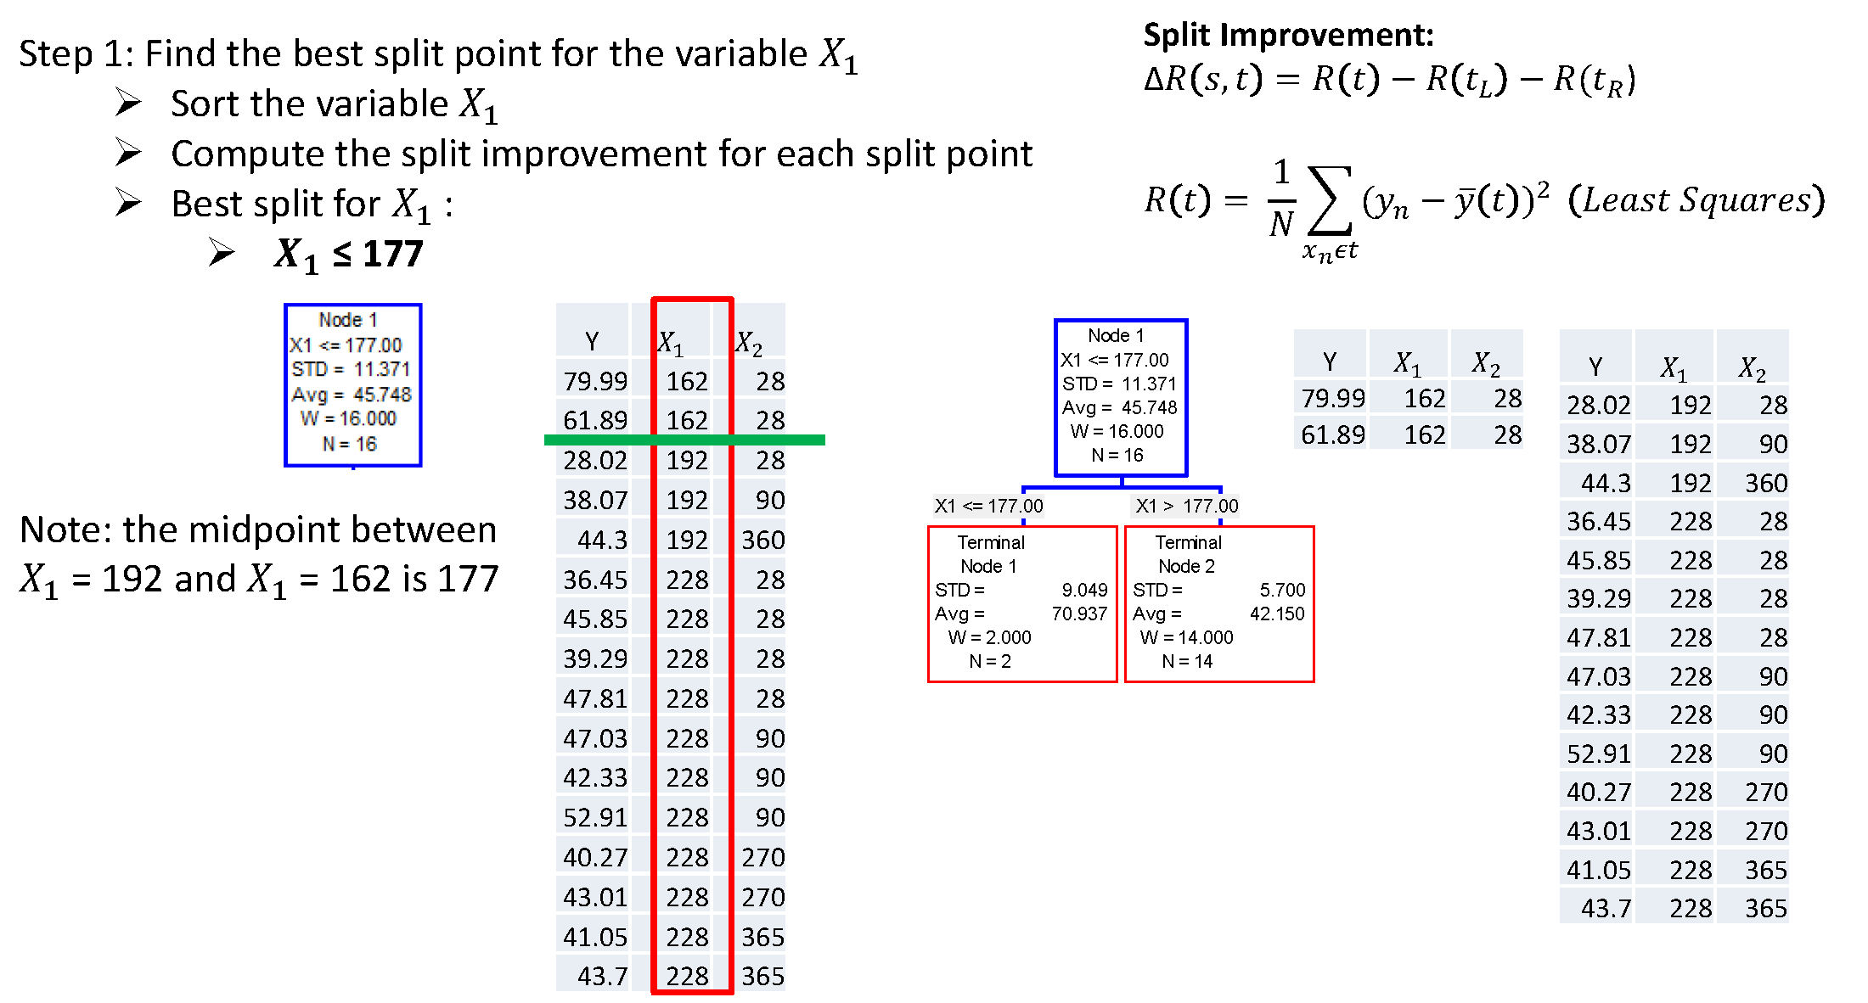
Splitting Procedure - Regression
Notes:
Concrete strength example from engineering

Slide 18
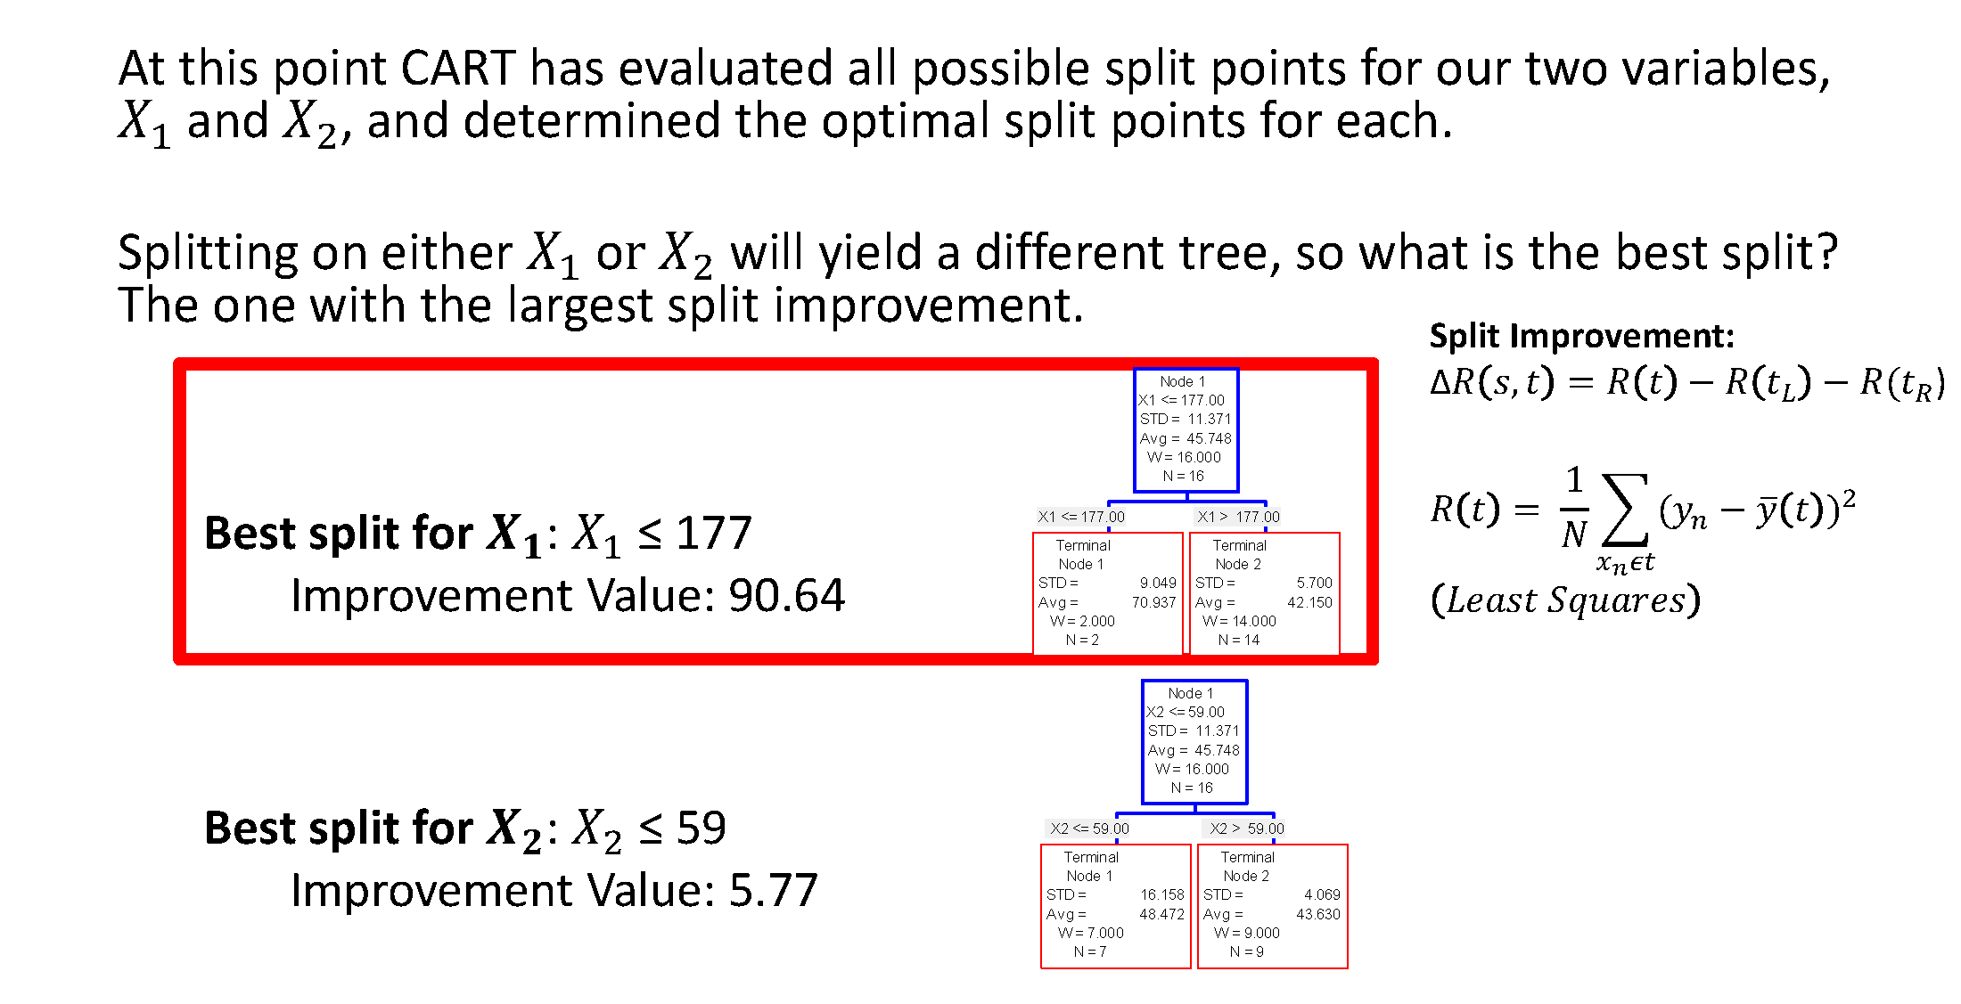
Splitting Procedure - Regression

Slide 19
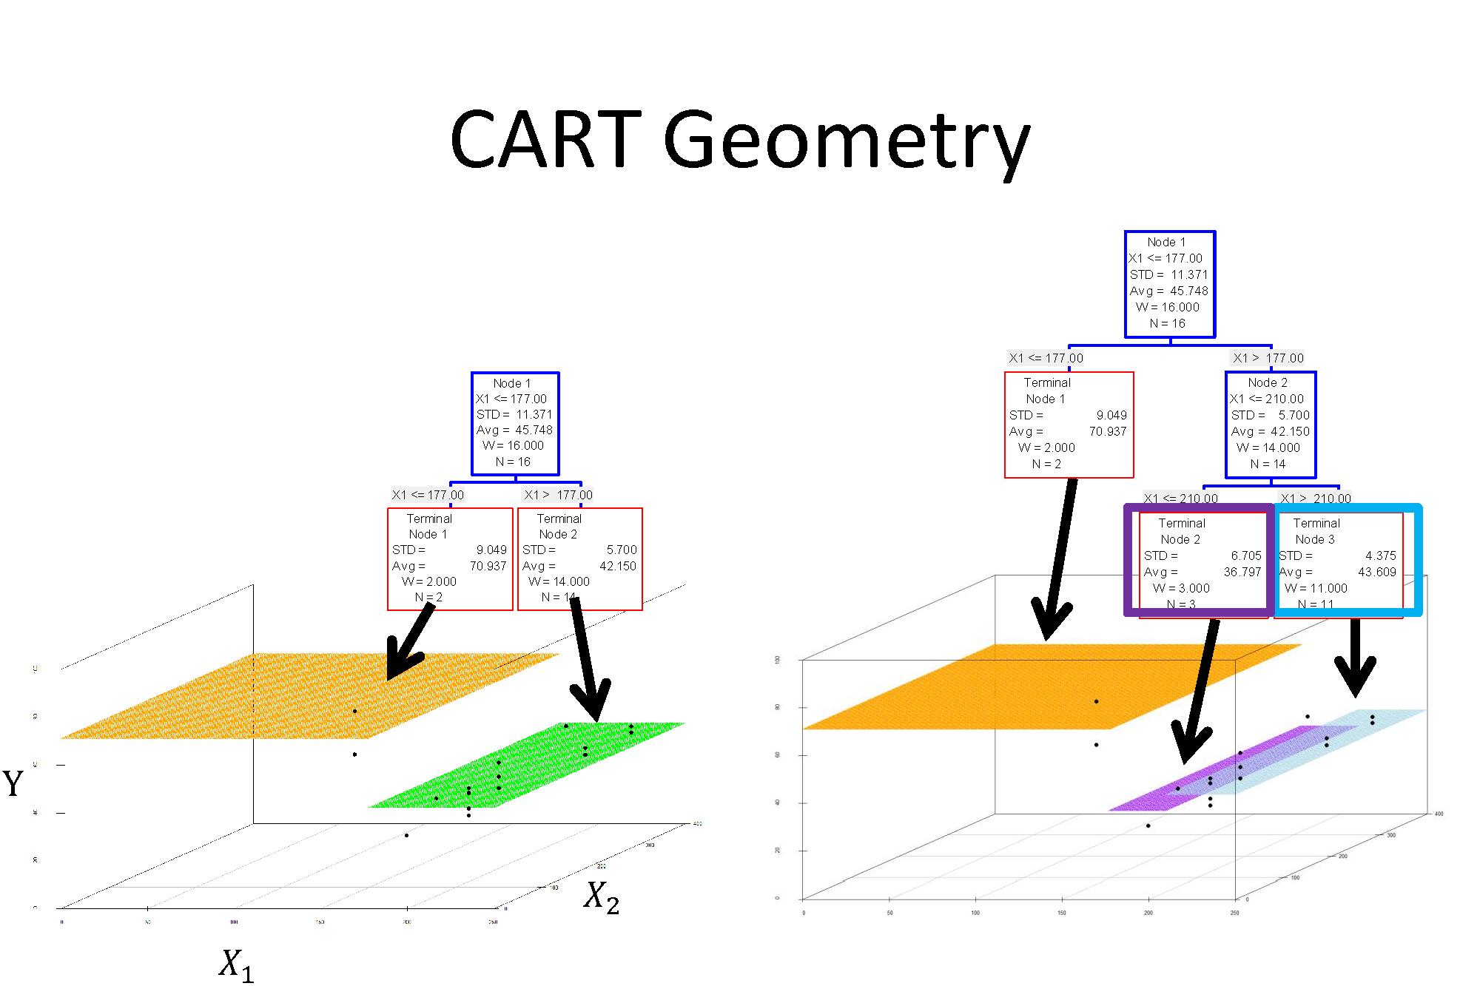

Slide 20
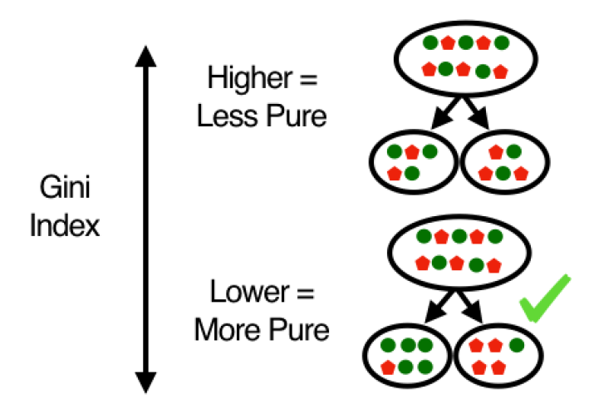
Splitting Procedure - Classification
Notes:
Mention information gain and its relation to Shannon’s Entropy from day 1

Slide 21
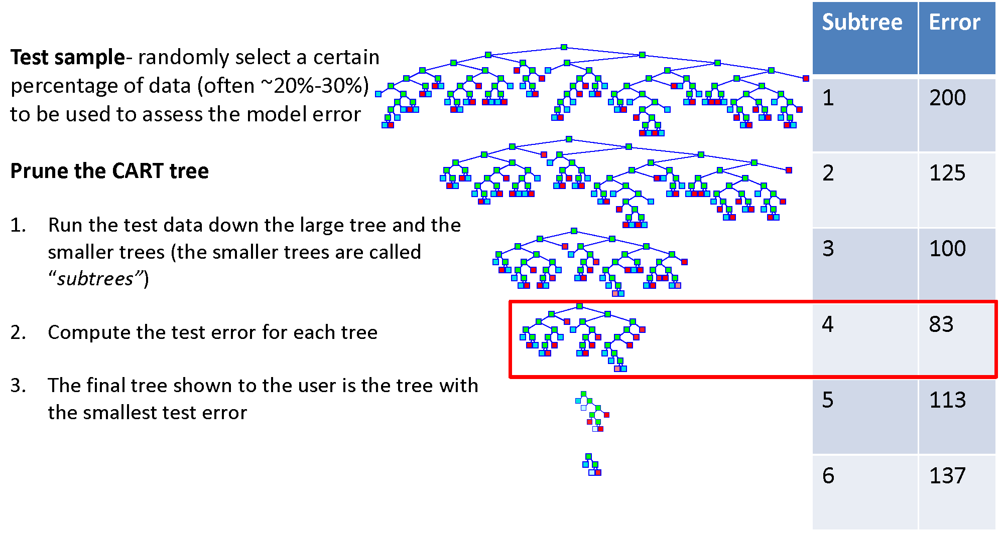
Pruning

Slide 22
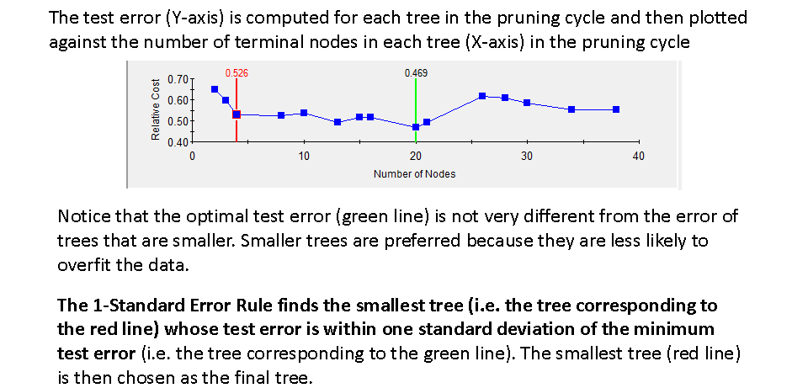
Pruning

Slide 23
Model Evaluation
Producer’s accuracy
The probability of a reference pixel being correctly classified.
Omission error – samples are omitted from the correct class
User’s accuracy
The probability that a pixel classified on the map represents that category on the ground.
Commission error – samples are added to the incorrect class
Overall accuracy
Computed by dividing the total correct (i.e., the sum of the major diagonal) by the total number of pixels in the error matrix
Notes:
Revisit from day1 - uncertainty

Slide 24
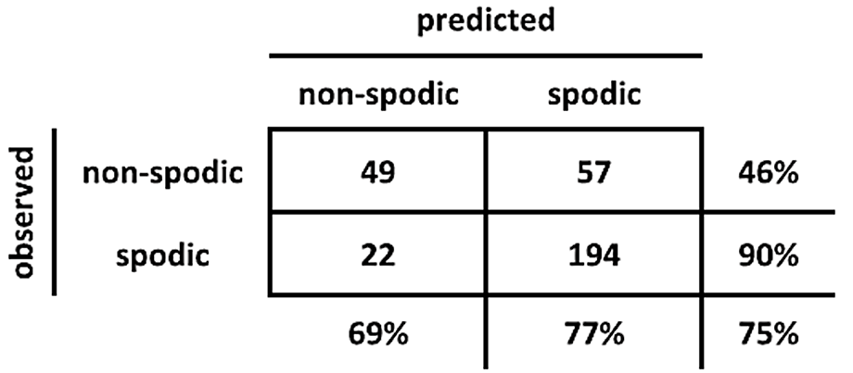
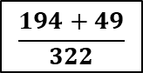
Model Evaluation
User’s
Accuracy
49/106
194/216
Producer’s
Accuracy
49/71
194/251
$$\frac{194+49}{322}$$
Overall
Accuracy
Notes:
Revisit from day1 - uncertainty

Slide 25
Exercise: Rpart
Part 1:
Exploratory Data Analysis
Part 2:
Regression trees with rpart
Pruning and cost complexity parameter
Eval with RMSE
Part 3:
Classification tree with GINI and Information Gain
Eval with confusion matrices, overall accuracy and kappa
Notes:
Link to pdf and .R script

Slide 26


Slide 27
Exercise:
Part 1:
Correlation Plot:
Part 2:
Evaluate results from regression trees
Part 3:
Compare splitting criteria for classification trees

Slide 28
Summary - rpart
rpart(formula, data, method, control)
formula response~predictor1+predictor2+predictorx
data= specifies the dataset
method= “class” for classification tree
“anova” for regression tree
control= optional parameters for controlling tree growth
printcp( ) | displays complexity parameter (cp) table
plotcp ( ) | plots cross-validation results
summary ( ) | detailed results including surrogate splits
plot ( ) | plots the decision tree
text ( ) | labels the decision tree plot
prune ( ) | snips off the least important splits using cp
Notes:
Introduce the function - Run through an example - Then discuss the optional parameters

Slide 29
Outline
Part 2 – Random Forest models
Random Forest Methods
Bootstrap Aggregation and Bagging
Variable Importance and OOB
Gradient Descent
Ranger package
Boosted tree models
Deep Learning

Slide 30
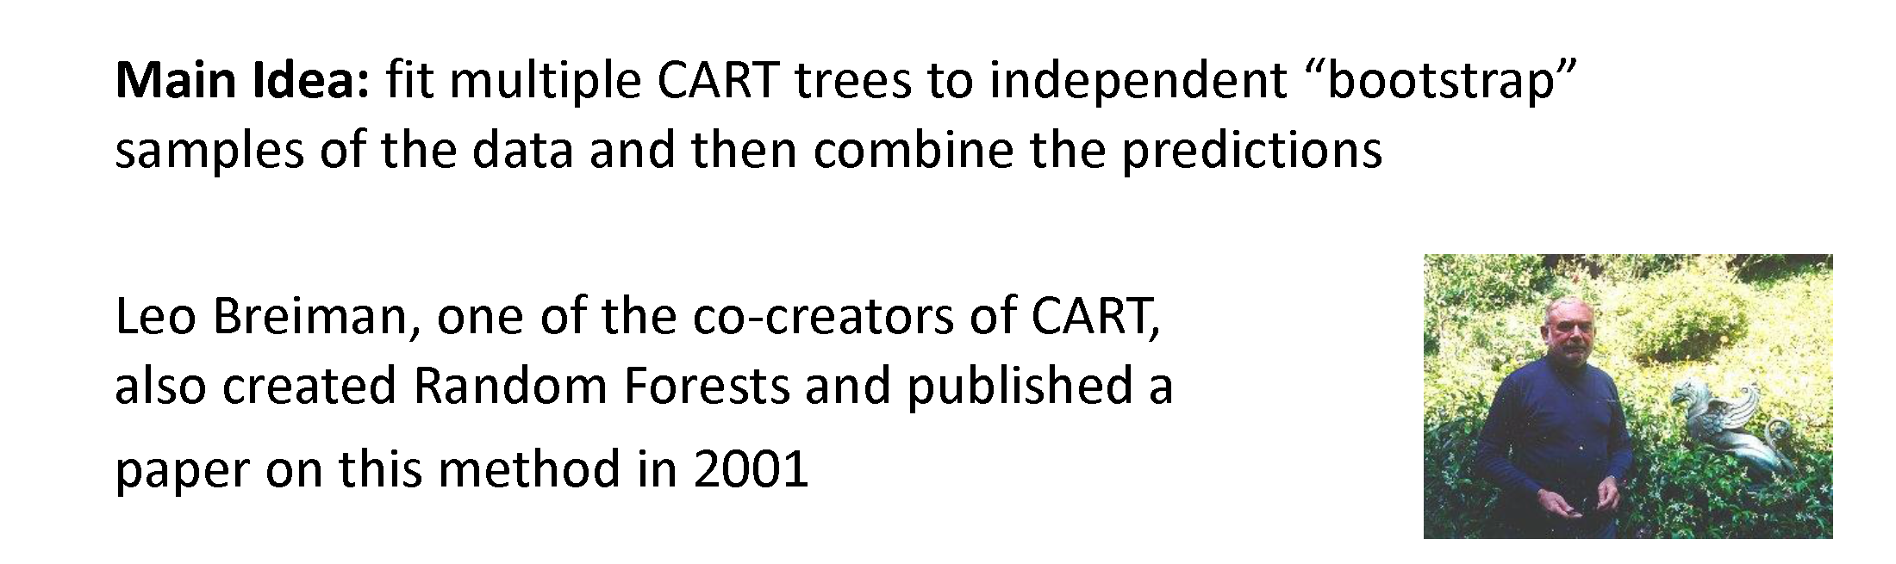
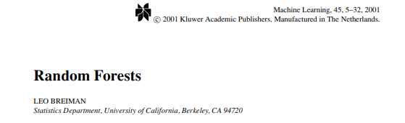
Random Forest Method
Notes:
Breiman and Cutler

Slide 31
Random Forest Method
Grow a forest of many trees (ntree).
Grow each tree from an independent bootstrap sample from the training data (sample N cases at random with replacement).
For each tree at each node:
Select a random subset of predictor variables (mtry)
Use the best split on the selected mtry variables
Repeat this process until the tree is grown to the largest extent possible (no pruning)
Aggregate all trees for prediction (average for regression, majority vote for classification).
Notes:
Double random nature – mrty and bagging
Does not produce a single tree output like rpart because decisions are not made on a single binary tree….decisions are made using an ensemble of trees.

Slide 32
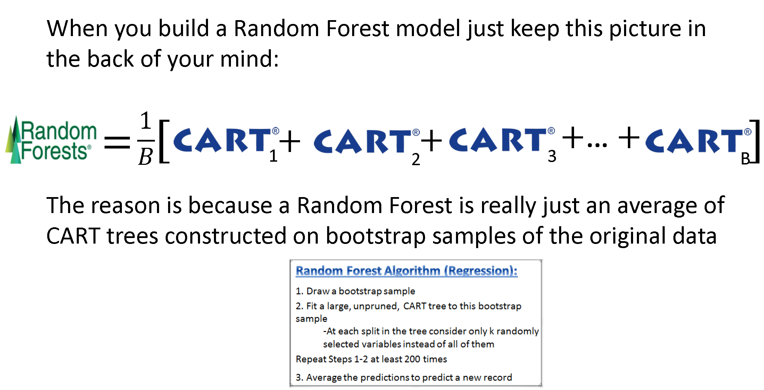
Random Forest Method

Slide 33
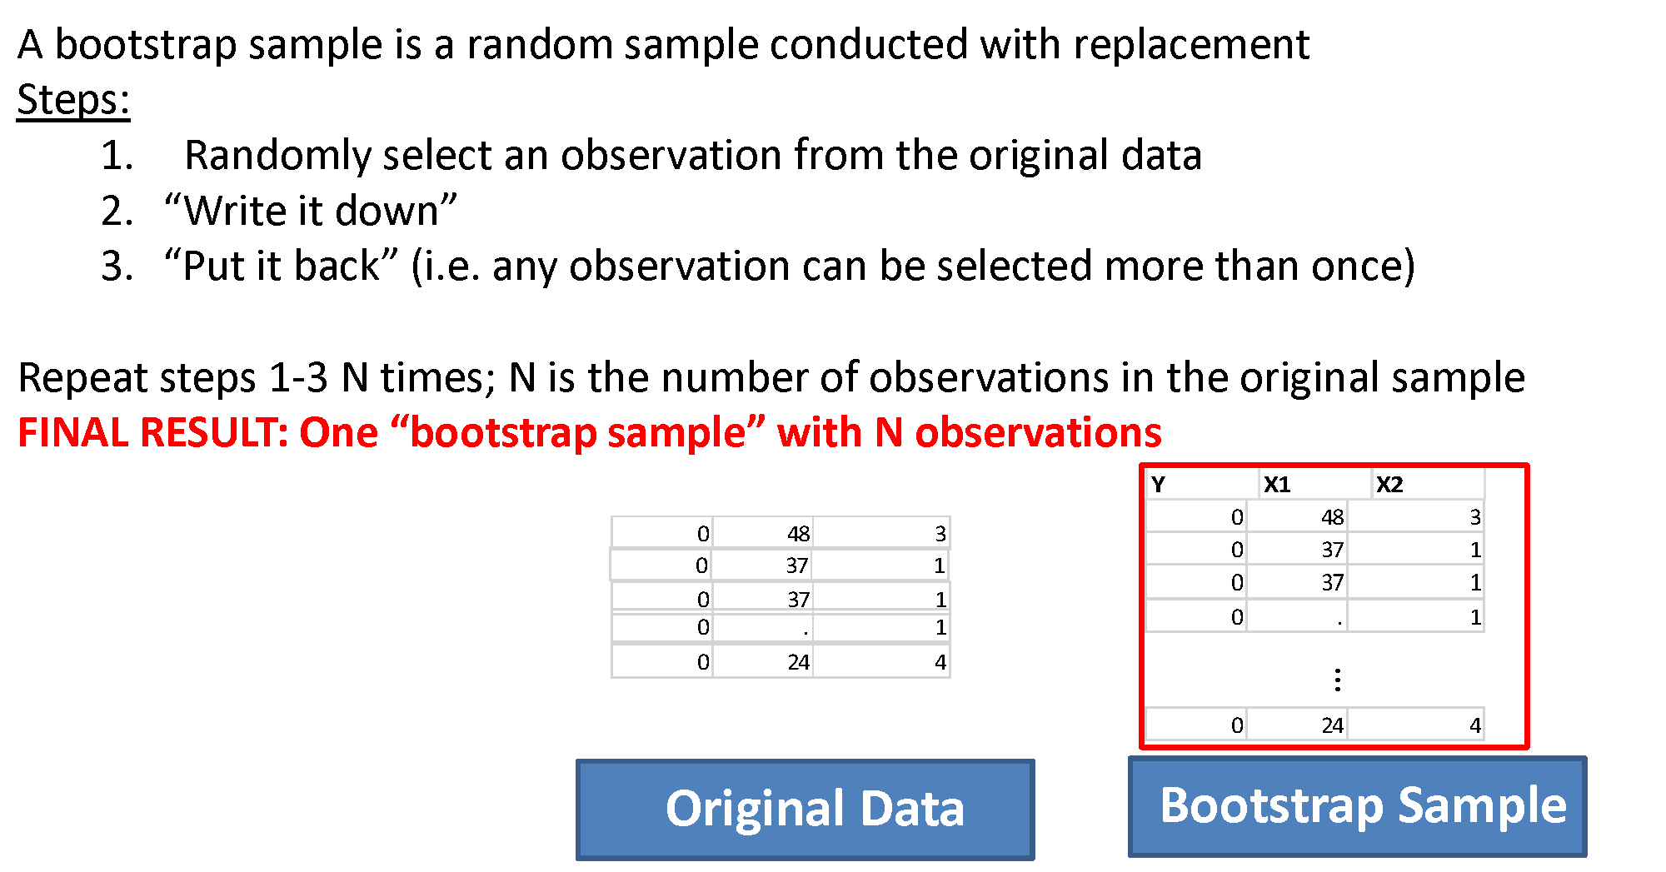
Bootstrap Aggregation

Slide 34
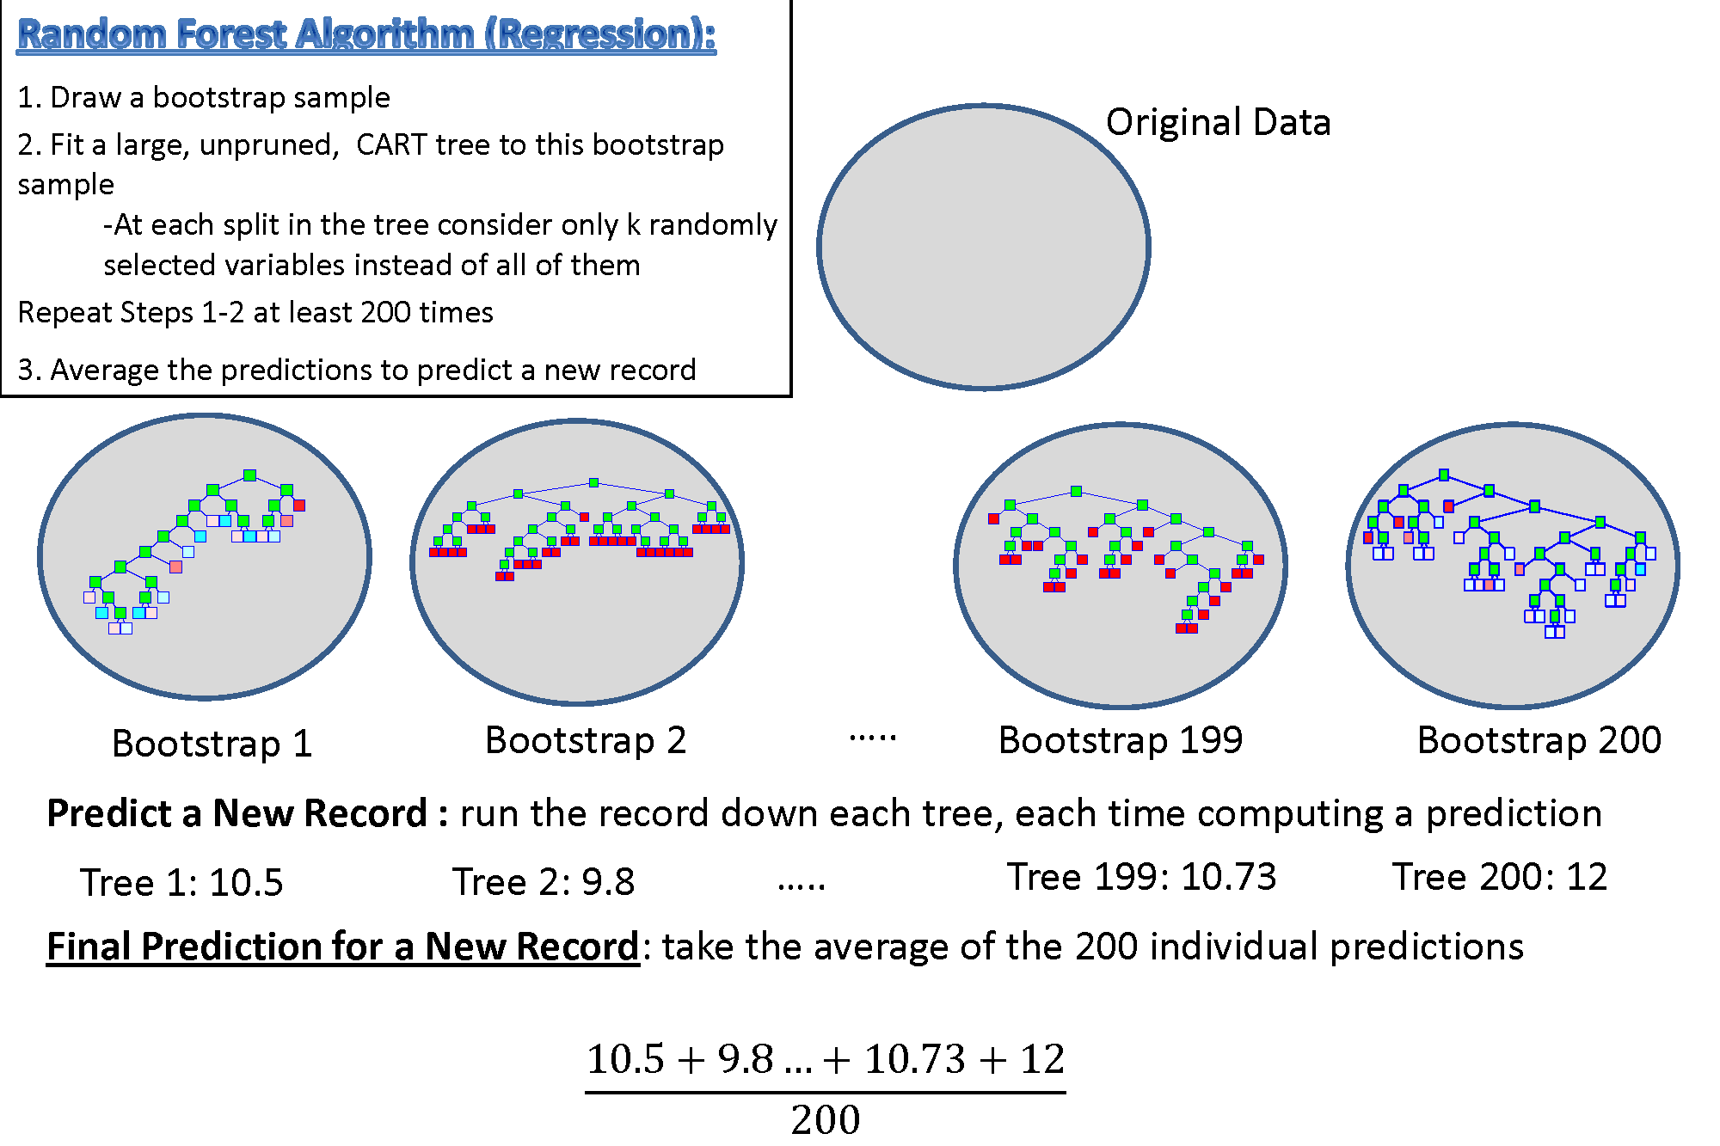

Slide 35
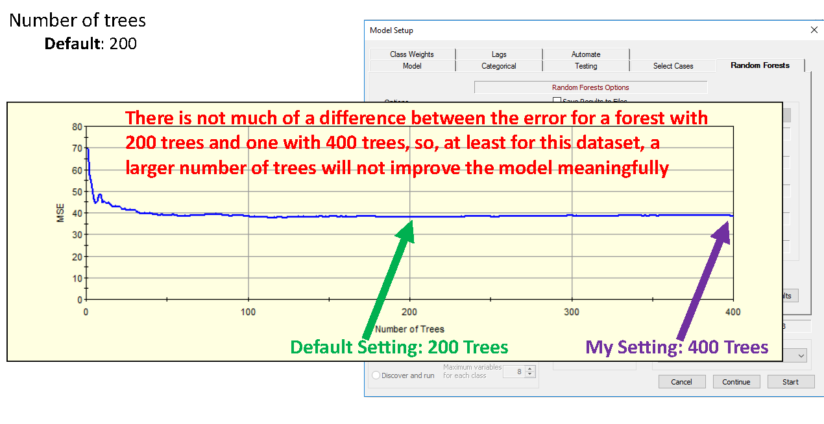
Random Forest Method - ntree

Slide 36
Regression Terms
%Inc MSE
average increase in squared residuals of the test set when variables are randomly permuted (little importance = little change in model when variable is removed or added)
Inc Node Purity
increase in homogeneity in data partitions
Mean of Squared Residuals
sum of squared residuals divided by n
% Variance Explained
psuedo R²
Notes:
The %IncMSE is the difference between the prediction errors averaged over all trees, normalized by the standard deviation of the differences.
The IncNodePurity is measured by residual sum of squares as the total decrease in node impurities as a result of splitting on a given variable, averaged over all trees.

Slide 37
Classification Terms
Mean Decrease Accuracy
the more the accuracy of the random forest decreases due to the addition of a single variable, the more important the variable is deemed
Mean Decrease Gini
a measure of how each variable contributes to the homogeneity of the nodes and leaves
Out of Bag Error
proportion of times that the result is misclassified, averaged over all samples

Slide 38
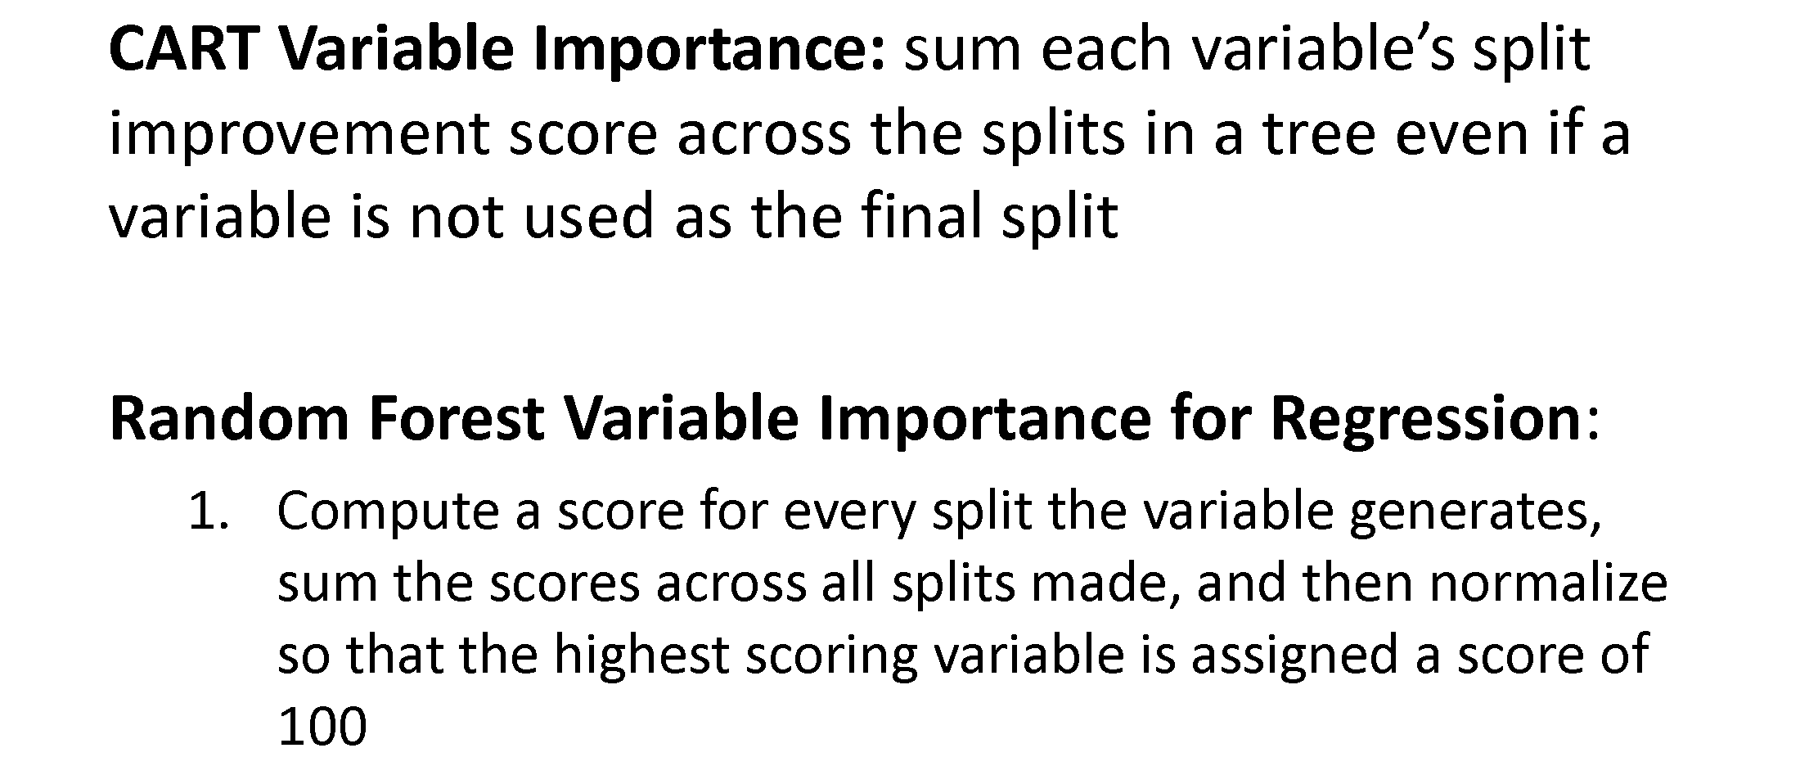
Variable Importance
The importance of each variable is estimated by observing how much the prediction error increases when out-of-bag (OOB) data for that variable are permuted while all others are left unchanged.

Slide 39
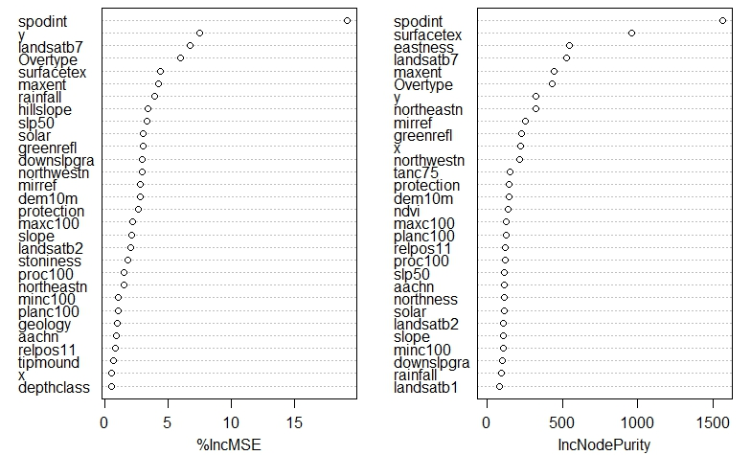
Variable Importance
Notes:
Useful to reduce multicolinearity

Slide 40
Gradient Descent for Model Tuning
Used to Determine the Optimal Combination of Input Parameters
Build a table all reasonable input parameters
ntree
mtry
nodesize
Build models for every possible combination and compare OOB error estimates across each model
The final model will have the ideal set of parameters that minimizes the OOB error estimate
Notes:
Relate to deep learning and the gradient descent origins
Computationally intensive!! Runn many many different models
Need for something like Ranger

Slide 41
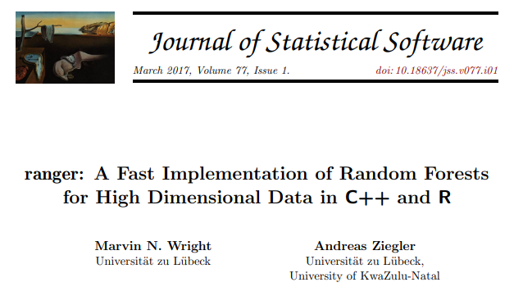
Ranger package
Notes:
Mention the exercise

Slide 42
Ranger package
Fast Implementation of Random Forest
Based of original RF code from Breiman and Cutler
Tips for efficient code
Useful with benchmarking for efficient code
Avoid growing a vector – see link for detail
Microbenchmark and system.time

Slide 43
Boosting Algorithms
Adaboost
GBM - Gradient Boosting Machine
XGB – Extreem Gradient Boosting
Boosting Methods:
Fit a decision tree
Fit a second decision tree to model residuals
Add models together and repeat this process for n iterations
Need to balance Performance with Over-fitting

Slide 44
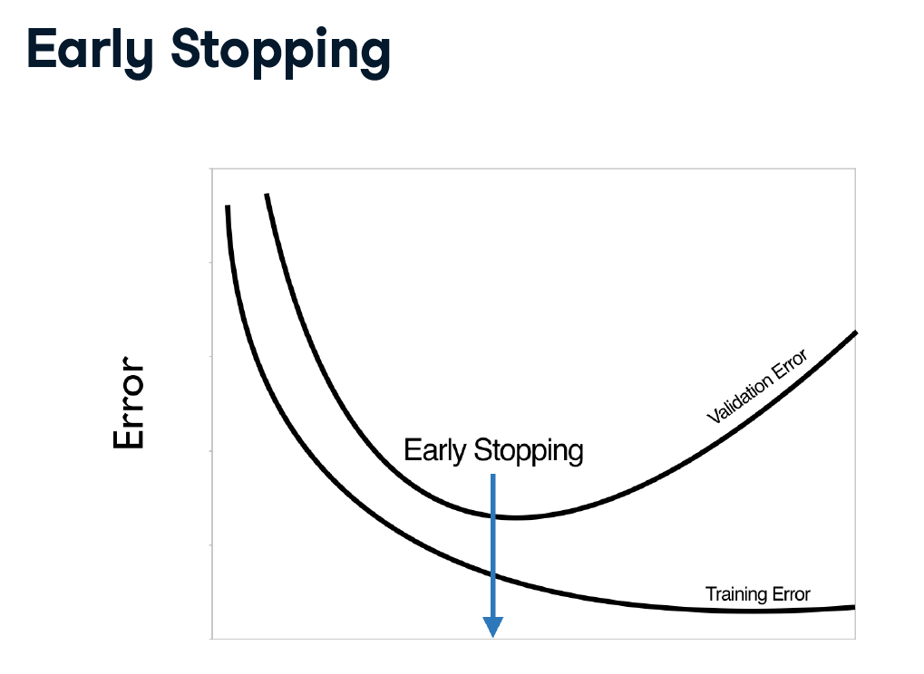
Training Epochs

Slide 45
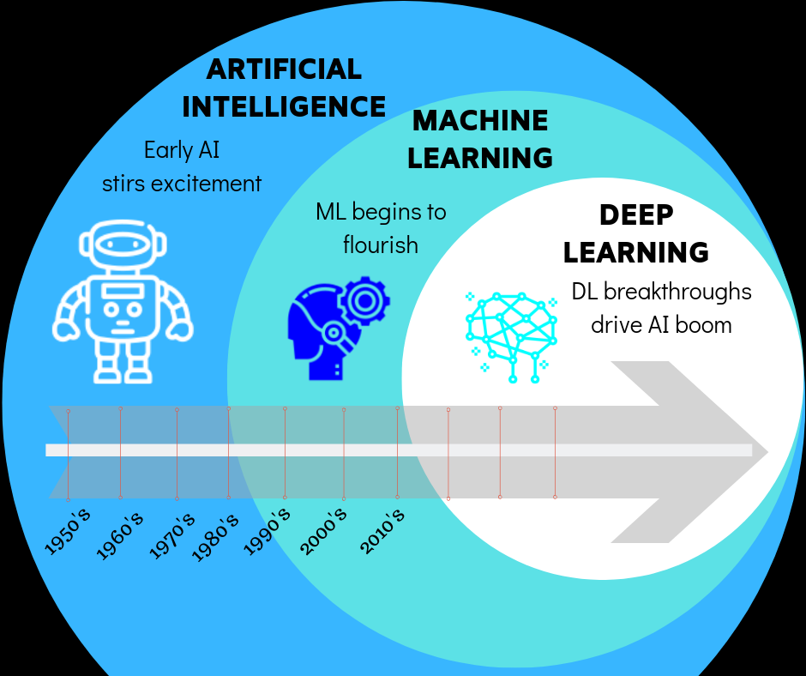
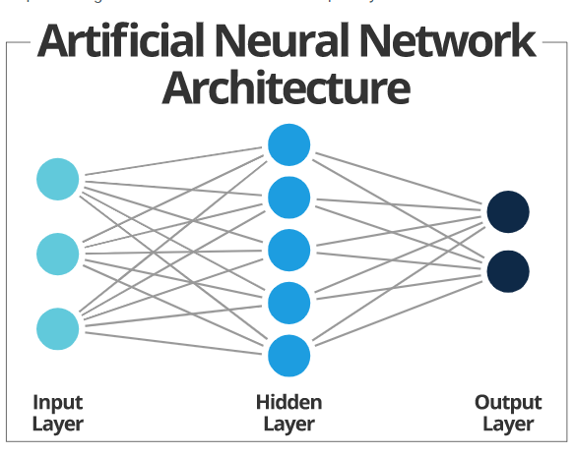
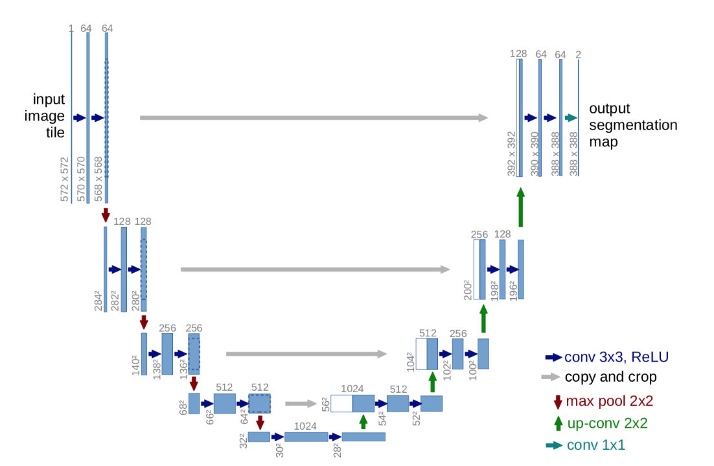
Deep Learning State of the Art in Classification Highly Accurate – very black box CNN for Image Processing (a. la. Unet) Hidden Layers and Activation Weights/Bias More info here
Notes:
1,000’s of parameters
sigmoid vs ReLU - backpropigation

Slide 46
Exercise: Rpart
Part 4:
Random Forest for Classification
Gradient Descent for Model Tuning
Part 5:
Fast Random Forest with Ranger
Benchmarking with system.time
Part 6:
Prediction with Random Forest
Mapping Land Cover from NAIP Imagery
Notes:
Link to pdf and .R script

Slide 48
Exercise: Random Forest
Part 4:
Effect of gradient descent
Part 5:
Performance boost with ranger
Part 6:
Mapping Land Cover from NAIP Imagery
Producing probability surface for land cover map
Notes:
Link to pdf and .R script

Slide 49
Summary - randomForest
randomForest(formula, data, importance)
formula response~predictor1+predictor2+predictorx
data= specifies the dataset
mtry= number of randomly sampled variables at
each node
ntree= number of trees to grow
importance= if TRUE, allows user to examine variable importance
varImpPlot ( ) | variable importance plot
importance ( ) | variable importance statistics
plot ( ) | plots out of bag (OOB) error rate versus number of trees
print( ) | model summary statistics

Slide 50
Exercise Summary:
Built regression and classification models with rpart
Built regression and classification models with random forest
Evaluated model predictions with an independent validation set
Used gradient descent for model tuning
Employed benchmarking to quantify performance increases from ranger
Mapped land cover from NAIP Imagery
Notes:
Interpret model outputs
Predict with rpart and random forest

Slide 51
Summary – Tree Models
Tree-based models are quick, intuitive, nonparametric, and are often ideal for exploratory data analysis and prediction
Both rpart and randomForest packages perform internal validation (rpart=10-fold cross validation; randomForest=OOB error estimates)
In general, tree-based models are robust against multicollinearity and low n, high p datasets
Caveats
Outliers (model stability and over-fitting)
Model parameters (pruning for rpart; ntree and mtry for randomForest)

Slide 52
Review Questions
Why is random forest often referred to as double random?
How does random forest perform internal validation?
True or false – numerical and categorical data can be used in the creation of a classification tree?
What are some differences between rpart and randomForest?
Why is random forest often referred to as double random?
How does random forest perform internal validation?
True or false – numerical and categorical data can be used in the creation of a classification tree?
What are some differences between rpart and randomForest?
Why is random forest often referred to as double random?
How does random forest perform internal validation?
True or false – numerical and categorical data can be used in the creation of a classification tree?
What are some differences between rpart and randomForest?
Why is random forest often referred to as double random?
How does random forest perform internal validation?
True or false – numerical and categorical data can be used in the creation of a classification tree?
What are some differences between rpart and randomForest?

Slide 53

Always Remember…
“The combination of some data and an aching desire for an answer does not ensure that a reasonable answer can be extracted from a given body of data.”
–John Tukey

Slide 54


